Slide 1
Hire and Nurture Program
SQL Server Database training – Session4
January 2021

Slide 2
Agenda
Constraints
Nested Queries
Joins
Indexes
Stored Procedures, UDF, Views
Query optimization
SQL Profiler and DTA (Database tuning Advisor)
Tips and Tricks for DBMS performance tuning

Slide 3
Exercise
Joins
Nested Queries

Slide 4

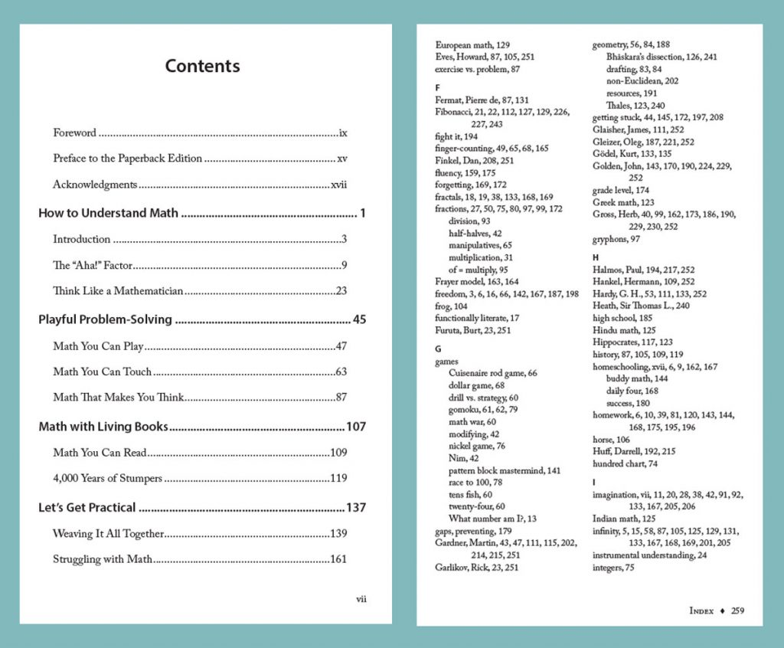
Indexes
Indexes are used in relational databases to quickly retrieve data. They are like indexes at the end of the books whose purpose is to find a topic quickly.
A clustered index stores data rows in a sorted structure based on its key values. Each table has only one clustered index because data rows can be only sorted in one order. The table that has a clustered index is called a clustered table.
A nonclustered index is a data structure that improves the speed of data retrieval from tables. Unlike a clustered index, a nonclustered index sorts and stores data separately from the data rows in the table. It is a copy of selected columns of data from a table with the links to the associated table.
1 Clustered Index | 999 Non-Clustered Indexes

Slide 5
Exercise
Indexes

Slide 6
Exercise
Stored Procedures
Views
UDF

Slide 7
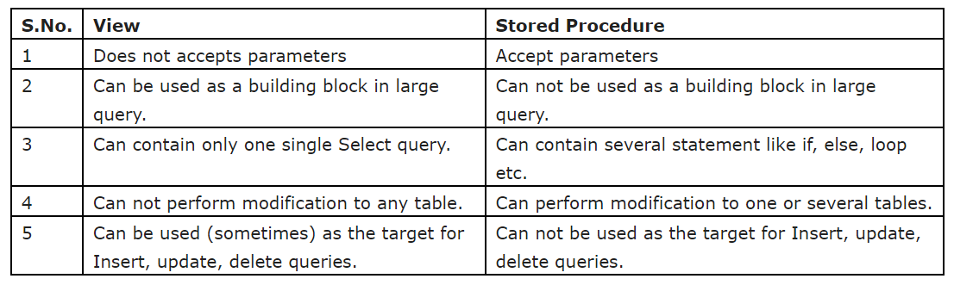
Stored Procs and Views
Views: Database views allow you to create "virtual tables" that are generated on the fly when they are accessed. A view is stored on the database server as an SQL statement that pulls data from one or more tables and (optionally) performs transformations on that data
Stored Procedure : Stored procedures are precompiled database queries that improve the security, efficiency and usability of database client/server applications. Developers specify a stored procedure in terms of input and output variables.

Slide 8
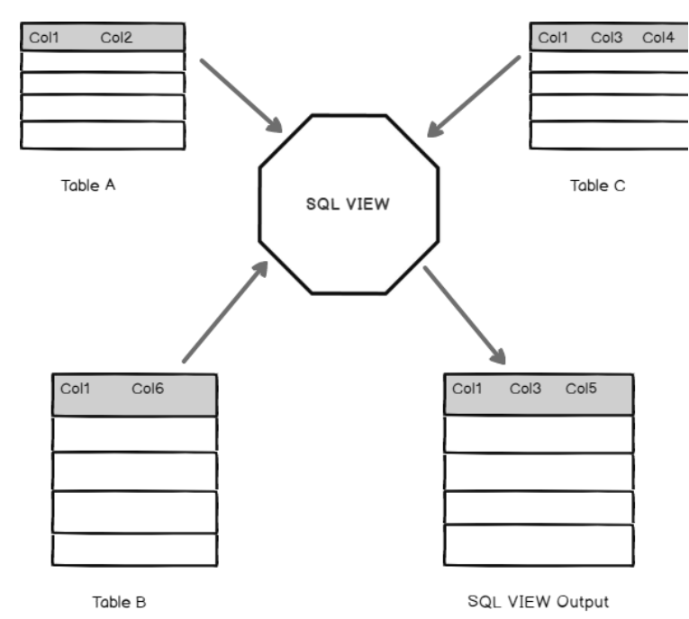
Views
We can use SQL VIEW to insert, update and delete data in a single SQL table. We need to note the following things regarding this.
We can use DML operation on a single table only
VIEW should not contain Group By, Having, Distinct clauses
We cannot use a subquery in a VIEW in SQL Server
We cannot use Set operators in a SQL VIEW

Slide 9
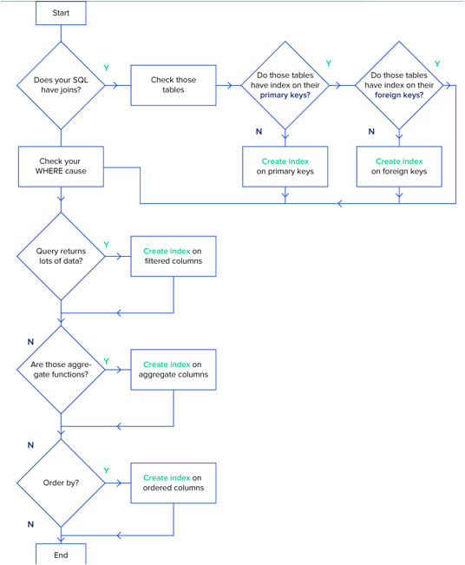
SQL Performance Tuning: Indexes
If you’re a complete newcomer to databases and even asking yourself
“What is SQL performance tuning?”, you should know that indexing is an effective way to tune your SQL database that is often neglected during development. In basic terms, an index is a data structure that improves the speed of data retrieval operations on a database table by providing rapid random lookups and efficient access of ordered records.
If you’re new to indexes, use this diagram when structuring your queries which gives you an idea to index the major SEARCHING and ORDERING columns

Slide 10
Query Optimization – Understanding the Basics
What is Query Processing in DBMS?
Database management systems like SQL Server have to translate the SQL queries you give them into the actual instructions they have to perform to read or change the data in the database. After processing, the database engine then also attempts to automatically optimize the query where possible.
What is Performance tuning in SQL Server?
Performance tuning includes query optimization, SQL client code optimization, database index management, and in another sense, better coordination between developers and DBAs.
What is Query Optimization in SQL Server?
Query optimization is when a developer, or the database engine, changes a query in such a way that SQL Server is able to return the same results more efficiently. Sometimes it's a simple as using EXISTS() instead of COUNT(), but other times the query needs to be rewritten with a different approach.
What is the of an Index in SQL Server?
An index tracks a targeted subset of a table's data so that selecting and ordering can be done much faster, without the server having to look through every last bit of data for that table.
Why is Exists() faster than Count() ?
EXISTS() stops processing as soon as it finds a matching row, whereas COUNT() has to count every row, regardless of whether you actually need that detail in the end.

Slide 11
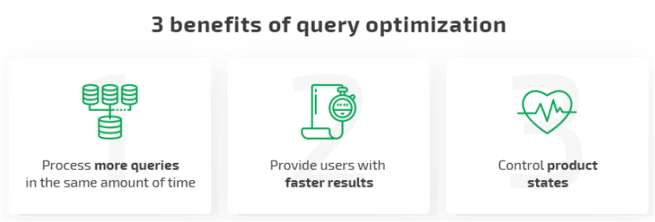
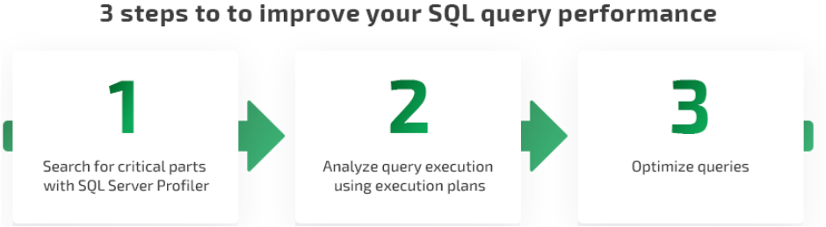
Query Optimization
Query optimization is essential for reducing the system resources required to fulfill a query and allowing the system to handle more queries simultaneously.
In a nutshell, there are three SQL server query optimization steps:
Detect critical parts that need to be improved.
Analyze problematic query execution to find out which actions cause poor performance.
Optimize queries by improving query execution plans.

Slide 12
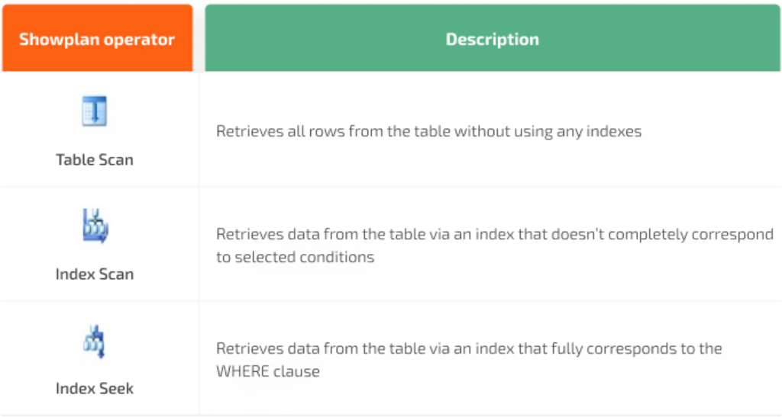
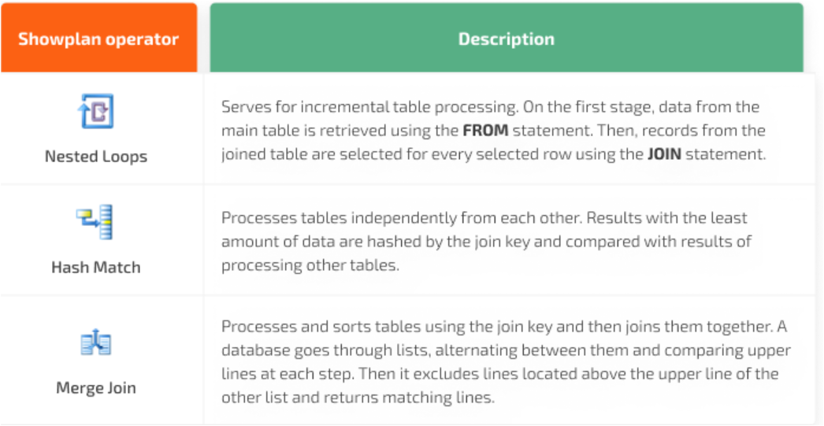
Query Optimization
When analyzing queries, pay attention to the parts that show how data is retrieved from the table and how results from several tables are joined.
There are several basic ways you can extract data from a table:
Main ways to join several tables

Slide 13
Exercise
Performance tuning exercises
SQL Server Profiling
DTA

Slide 14
10 Database Performance Tuning Best Practices
Keep statistics up to date
Table statistics are used to generate optimal execution plans. If the performance tuning tool is using out-of-date statistics, the plan won’t be optimized for the current situation.
Don’t use leading wildcards
Leading wildcards in parameters force a full table scan, even if there is an indexed field inside the table. If the database engine must scan all the rows in a table to find what it’s looking for, the delivery speed of your query results suffers. Other queries may suffer as well, since scanning all of that data into memory will cause the CPU utilization to spike and not allow other queries any time in memory.
Avoid SELECT *
This tip is particularly important if you have a large table (think hundreds of columns and millions of rows). If an application only needs a few columns, include them individually instead of wasting time querying for all the data. Again, reading extra data will cause CPU utilization to spike and memory to be thrashed. You should check the Page Life Expectancy (PLE) to make sure you are not having this issue.
Use constraints
Constraints are an effective way to speed up queries and helps the SQL optimizer come up with a better execution plan, but the improved performance comes at the cost of the data requiring more memory. The increased query speed may be worth it depending on the business objective, but it’s important to be aware of the price.
Look at the actual execution plan, not the estimated plan
The estimated execution plan is helpful when you are writing queries because it gives you a preview of how the plan will run, but it is blind to parameter data types which could be wrong. To get the best results when performance tuning, it’s often better to review the actual execution plan because it uses the latest, most accurate statistics.

Slide 15
10 Database Performance Tuning Best Practices
Adjust queries by making one small change at a time
Making too many changes at once tends to muddy the waters. A better, more efficient approach to query tuning is
to make changes with the most expensive operations first and work from there.
Adjust indexes to reduce I/O
Before you dive into troubleshooting I/O directly, first try adjusting indexes and query tuning. Consider using a covering index that includes all the columns in the query, this reduces the need to go back to the table as it can get all the columns from the index. Adjusting indexes and query tuning have a high impact on almost all areas of performance, so when they are optimized, many other performance issues resolve as well.
Analyze query plans
Utilizing artificial intelligence to analyze your execution plan and determine how to change it helps databases execute operations more efficiently.
Compare optimized and original SQL
When optimizing SQL queries, be sure to highlight changes in the SQL statement so you can compare the original statement with the optimized version. Gather a baseline metric such as logical I/O to compare against as you tune. Don’t make any changes until you are sure the optimized version is accurate (i.e., includes current statistics) and really does improve performance.
Automate SQL optimization
Automated SQL optimization tools not only analyze your SQL statement but can also automatically rewrite it or optimize indexes until it finds the variation that creates the most improvement in the execution time of the query.

Slide 16

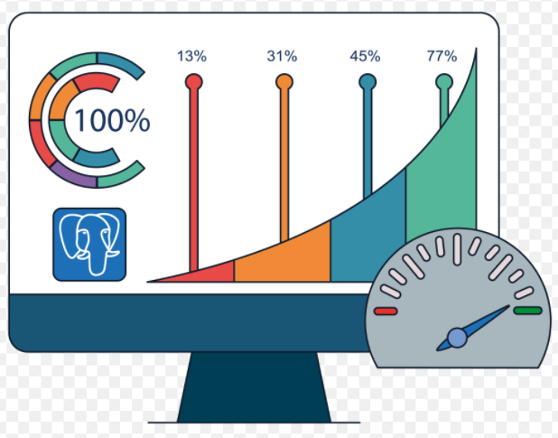
SQL Server Performance tuning Tips and Tricks
Avoid Null value in the fixed-length field
Normalize tables in a database
Keep Clustered Index Small
Use Appropriate Datatype
Store image path instead of the image itself
USE (CTEs) instead of Temp table
Use Appropriate Naming Convention
Use UNION ALL instead of UNION
Use Small data type for Index
Use Stored Procedure
Use Between instead of In
Use If Exists to determine the record
Never Use ” Sp_” for User Define SPs
Practice to use Schema Name
Avoid Cursors
SET NOCOUNT ON
Use Try–Catch
Remove Unused Index & Always create an index on the table
Use Foreign Key with the appropriate action
Use Alias Name & Use Index Name in Query
Drop Index before Bulk Insertion of Data
Use Unique Constraint and Check Constraint
Importance of Column Order in index
Recompiled Stored Procedure
Use Sparse Column
Avoid Loops In Coding
Avoid Correlated Queries
Avoid index and join hints
Avoid Use of Temp table
Use Index for required columns
Don't use Index
Use View for complex queries
Make Transaction short
Use Full-text Index

Slide 17
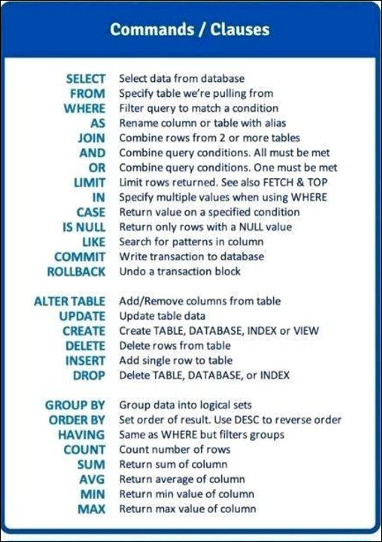
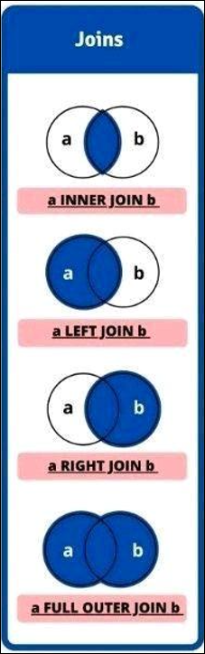
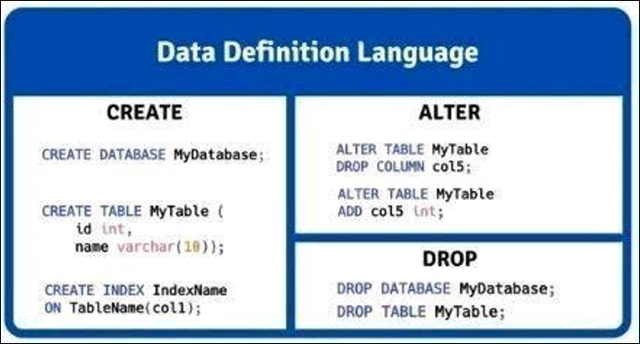
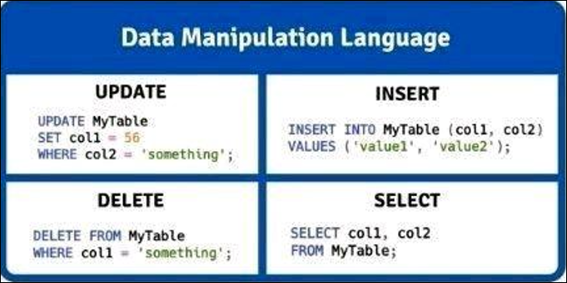
SQL Quick Brush Up

Slide 18
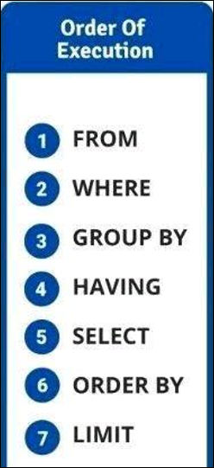
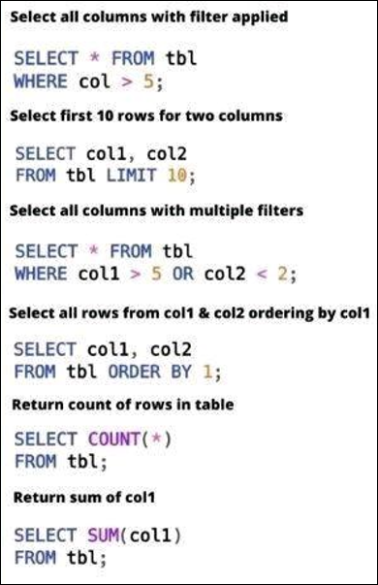
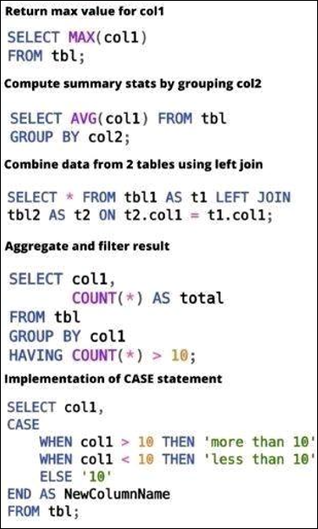
SQL Query Examples

Slide 19
SQL Files for Hands on
Sequence | Script Name | Comments
1 |  | Script will create a Database and then Tables with master data
2 |  | Practice sample SQL Queries
3 |  | Nested Queries
4 |  | Stored Procs and Views
5 |  | SQL Joins
6 |  | Only sample shared, please go through this link - > https://www.apriorit.com/dev-blog/381-sql-query-optimization

Slide 20
References/Articles links
https://www.tutorialspoint.com/sql/
https://www.mssqltips.com/
Articles or Blogs
https://www.sqlshack.com/
https://blog.sqlauthority.com/

